Slide 1
Social Justice in Counselling Psychology
JASPREET TEHARA (Doctoral Candidate Psych D)

Slide 2
Introduction
Counselling Psychology Doctoral Candidate
University of Roehampton
Predominant focus on Race (and some sexuality)
PERSPECTIVES:
CLIENTS PRACTITIONERS
THE BPS THE PROFESSION
Notes:
My name is Jazz, and I’m a doctoral candidate at the University of Roehampton, currently researching bisexuality in South Asian communities.
So very briefly, I’m going to try and outline the positions of Counselling psychology from various positions, including clients, The BPS, practitioners and the profession.
I want to thank Martin for inviting me here to take part in the first session – I hope I can deliver some content for you to take away, or to help open up some discussion on the themes of this year’s conference – which, I am informed are the mammoth subjects of social justice and intersectionality and how they interact with Counselling Psychology.

Slide 3
Social Justice
“social justice assigns rights and duties in the institutions of society, which enables people to receive the basic benefits and burdens of cooperation […] to ensure FAIR DISTRIBUTION OF WEALTH, AND EQUAL OPPORTUNITY.”
(Rawls, 1971/2009)
Notes:
So if you’re not aware of either of those, a very quick explanation or summary is that social justice is the concept of the redistribution of opportunity in an equitable manner for those who are disadvantaged to promote a societal sense of fairness, based on the many historical injustices bestowed on people throughout history, be they economic, social, political or educational.

Slide 4
Intersectionality
“Intersectionality (Crenshaw, 1989) may be defined as a theory to analyse how social and cultural categories intertwine. The relationships between gender, race, ethnicity, disability, sexuality, class and nationality are examined.”
(Knudsen, 2006)
Notes:
Intersectionality (Crenshaw, 1989) is the idea that multiple identities intersect to create a whole that is not equal to its constituent parts. For example, you can be Gay, cisgendered, and white, or you could be Gay, nonbinary and Black, and although you may both be at the intersection of gay, your subsequent intersections will not be the same – resultantly, your experience will not be the same.

Slide 5
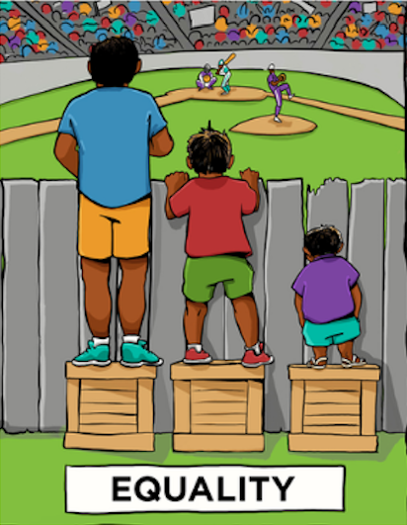
Equality
Notes:
I’m sure you would have noticed I used the word “equitable,” earlier. For many, the idea of social justice is in the understanding of fairness – and equality. Equal rights in the LGBT community, for example is a common theme in the media and politics right now, however, I would argue that although gay marriage has been incorporated into the political sphere, and subsequently into the modern zeitgeist, this is not an act of equitability.

Slide 6
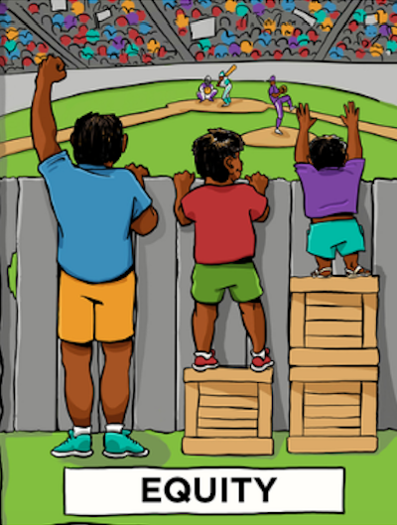
Equity
Notes:
Equitability digs deeper than equality to begin to address the larger disadvantages of other people’s so that they can attain the same access to healthcare, welfare, education, protection under law and so on and so forth.

Slide 7
RESEARCH FINDINGS (MIND & STONEWALL)
10% participants said services met “Cultural needs.” (68% said this didn’t matter). (MIND)
Therapists do not take into account religious and spiritual interactions with therapy. (MIND)
Cultural understandings of mental health were not taken into account. (MIND)
57% of healthcare workers (Nurses, Mental Health Nurses, Social workers) do not consider sexual orientation as important to healthcare. (STONEWALL)
25% of healthcare staff have received NO training in LGBT issues. (STONEWALL)
Notes:
Studies carried out in the last decade have highlighted, for example, that LGBT and BAME communities suffer disproportionately in access to counselling and psychotherapy, because the services are not there for them, the services are not made for them, and they’re less likely to be referred to services in the first instance.

Slide 8
Personal position
Working class Male
British Sikh
Cis-gendered Bisexual
(Heterosexually passing)
Thought: Heteronormativity as the predominant discourse. Why? Who set that agenda? When do we move into a place where it doesn’t matter in society? When we get there – will that be Liberation?
Notes:
My personal stance as a practitioner comes from the position of being from a working class background, being a minority ethnic in a suburban area out of greater London, (e.g. Kent), of being cisgendered, but of also being bisexual and from a Sikh heritage background. As a process of understanding those intersections and how they interact I’ve become acutely aware that representation of being from the LGBT community and of being from a BAME community is minimal at best.

Slide 9
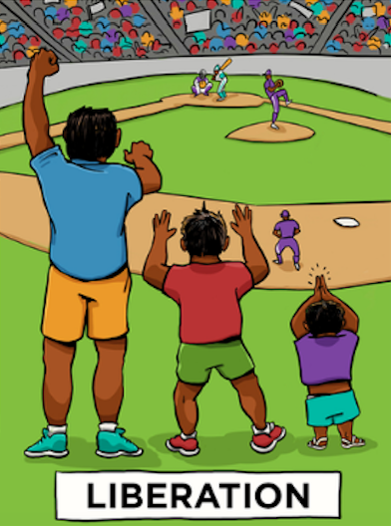
Liberation
Notes:
In modern parlance, we seem to, as a society, be playing catch up from a very Victorian, and some would argue imperialistic hangover, where attitudes to sex and sexuality were stymied in political and cultural spheres, and subsequently – we could eventually move into a place of Liberation, the space where these inequalities are addressed.

Slide 10
Social Justice in the Division (DCoP)
Psychologists in the UK = 22,521
(Female= 18212, Male= 4302, Unknown= 7)
Counselling Psychologists in the UK = 2164
(Female= 1779, Male = 384, Unknown=1)
Counselling Psychologists are 10% of registered Psychologists in the UK.
(HCPF FOI Request, 2016)
Notes:
So how do we frame the concept of social justice in the Division of Counselling Psychology?
I think an elementary and cursory look at the statistics recorded by the HCPC for example are indicative of a wider issue of representation and study in psychology.

Slide 11
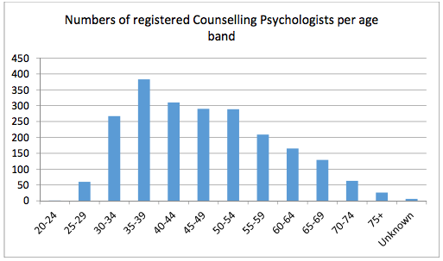
Social Justice in the Division (DCoP)
(BPS, 2015)
Notes:
The figures indicate that Counselling Psychologists are 10% of Psychology practitioners - that are predominantly female within the age ranges of 30-55 (1550 of practitioners). However, I looked at various sources, and there seems to be little information on breakdown of statistics in accordance with ethnicity or sexual orientation which I found interesting, having looked on the HCPC website, the BPS website, and various research sites – I couldn’t find a breakdown of race or ethnicity statistics for counselling psychologist practitioners. I also contacted the Black and Asian Counselling Psychologist Group (BACPG) from the BPS, who suggested that the information is not available yet, but that it’s being collected.
Subsequently, I also could not find information regarding Counselling Psychology trainees, which could have indicated the trajectory of trainee trends.

Slide 12
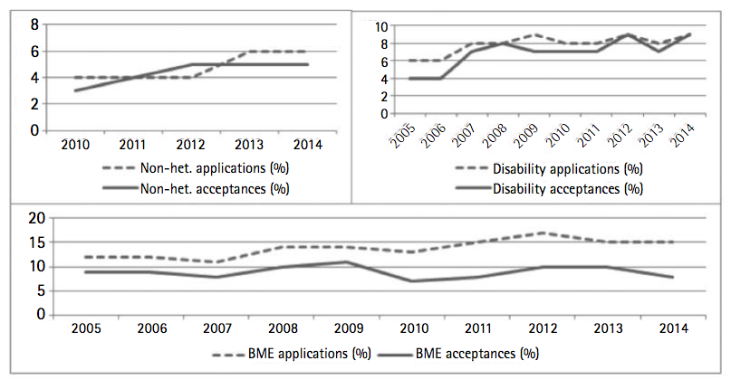
Social Justice in the Division (DCOP)
(DCP, 2016)
Notes:
Previous figures and statistics with regards to trainees have been published from the division of clinical psychology, and indicate that between 2005 and 2014 the number of applicants to clinical courses have gone up from 12% to 15%, but the number of accepted trainees from BAME communities has remained approximately between 5 and 10%. (Smith, 2016, BPS).
Similarly, the number of non-heterosexual applicants have gone from 4% in 2010, to 6% in 2014, but actual trainees accepted on to courses have gone from 3% to 5% in the same period.

Slide 13
CHALLENGES FOR BAME THERAPISTS
PRE TRANSFERENCE ISSUES (TELEPHONE VOICE vs. PHYSICAL PRESENTATION)
(Curry, 1964)
DOES RACE CHANGE THE TRANSFERENCE RELATIONSHIP?
(Dhillon-Stevens 2004)
MATCHING (SAMENESS vs. DIFFERENCE) &
INTERNAL OPPRESSOR (INVALIDATION OF PERSONAL AUTHENTICITY THROUGH LEARNING MODELS THAT DO NOT MEET CULTURAL EXPERIENCE)
(Lago, 2011)
Notes:
So when we begin to discuss the idea of Social Justice within the DCoP, as far as I could see, we didn’t have a baseline in order to begin to establish what could be done to execute positive change around the demographic of our practitioner base

Slide 14
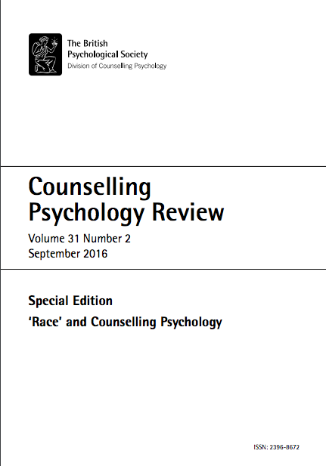
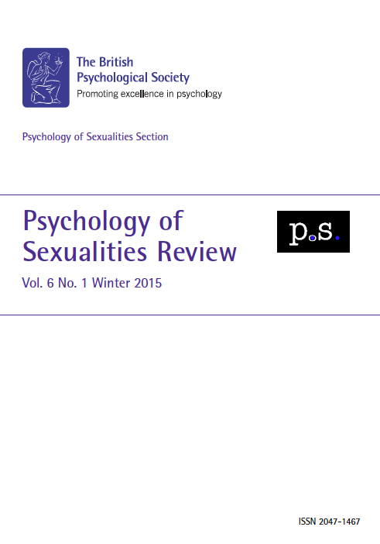
Notes:
Recently, however, I am aware, that the DCoP published the Counselling Psychology review, which was a Race and counselling special edition – and that makes for wonderful reading.
The BPS also have the Psychology of Sexualities section which also send out their periodic reviews, and again, are great reading – especially if you’re interested in sexuality studies.

Slide 15
Current Issues
ETIC = Good counselling is good counselling, distress is cross-cultural and western concepts of ‘normality and abnormality’ can be applied across culture.
EMIC = Mental health distresses are related to cultural values and lifestyles.
(Neo & Akhurst, 2016)
Both positions are tenable and the practitioner on behaviours that are universal vs. those which are culturally significant.
(Sue & Sue, 2003)
Notes:
Current research published in the Counselling Psychology Review (Neo & Akhurst, 2016) highlighted some experience of minority counsellors in the North, as an IPA study. The introduction of this specific paper spoke to an ongoing discussion in the field which looks towards the etic and emic perspectives of counselling, which has become increasing pertinent as a discussion due to the multicultural nature of the population.

Slide 16
Challenges to hegemonic discourses
Languani (2004) suggests cross-cultural factors need to be thought of dimensionally from Eastern and Western perspectives.
Cognitivism
Freewill
Materialism
Individualism Communalism
Spiritualism
Determinism
Emotionalism
Notes:
As mentioned earlier from the Stonewall and MIND data, these cultural issues impact mental health statistics in various ways and as practitioners we need to be aware of what they could be. Various authors have suggested models that could construct a semblance of how to think, and negotiate cultural issues.

Slide 17
Challenges to Hegemonic Discourses
“It is apparent then that according to Jung the non-Europeans arE primitive, that they have no history, that they exist in an emotional morass, that they have no will or thought, that things happen to them, that in the hierarchy of things they definitely reside below the white.”
Jung: A Racist (Dalal, 1988)
Notes:
I would also suggest that the impact for the practice of counselling psychology could benefit from ongoing critical analysis from differing perspectives because this is how we begin to challenge the hegemonic and Eurocentric approach to counselling as norm.

Slide 18
Challenges to hegemonic discourses
  “TACKLING INSTITUTIONAL RACISM IS ABOUT THE PURSUIT OF ORDINARYNESS, ABOUT CREATING THE CONDITIONS WHEREIN, AT A MINIMUM, ORGANISATIONS FULLY REFLECT THE ORDINARYNESS IN A MULTI-ETHNIC SOCIETY.”
  Institutional Racism: Can Psychotherapy change? (A. Cooper, 2010)
Notes:
Despite the etic approach and the common factors needed to establish a good therapeutic alliance, we need to balance this with multicultural awareness and understanding that help evolve research, data collection and the production of knowledges, and we can look at challenging ourselves as a profession to become more inclusive and ordinary as the demographics of people we are working with in our therapeutic practice.

Slide 19
Thank you

Slide 20
References
Arthur, N., & Collins, S. (2014). Counsellors, counselling, and social justice: The professional is political. Canadian Journal of Counselling and Psychotherapy/Revue canadienne de counseling et de psychothérapie, 48(3).
Cooper, A. (2010). Institutional Racism: Can Psychotherapy Change?. British Journal of Psychotherapy, 26(4), 486-501.
Cutts, L. A. (2013). Considering a social justice agenda for counselling psychology in the UK. Counselling Psychology Review, 28(2), 8-16.
Dalal, F. (1988). Jung: a racist. British Journal of Psychotherapy, 4(3), 263-279.
Goodman, L. A., Liang, B., Helms, J. E., Latta, R. E., Sparks, E., & Weintraub, S. R. (2004). Training counseling psychologists as social justice agents: Feminist and multicultural principles in action. The Counseling Psychologist, 32(6), 793-836.
HCPC (2017).Gender Breakdown
http://www.hcpc-uk.org/assets/documents/10005450GenderbreakdownodRegistrants.pdf Accessed on 2nd June 2017
HPCP (2016). Psychologist Modality Breakdown
http://www.hcpc-uk.org/assets/documents/10005292PractitionerPsychologistModality.pdf Accessed on 2nd June 2017
Knudsen, S. V. (2006). Intersectionality–A theoretical inspiration in the analysis of minority cultures and identities in textbooks. Caught in the Web or Lost in the Textbook, 53, 61-76.
Laungani, P. (2004). Asian perspectives in counselling and psychotherapy. Routledge.
Mind (2013). We Need to Talk coalition. We still need to talk: a report on access to talking therapies. Accessed on 2nd June 2017: https://www.mind.org.uk/media/494424/we-still-need-to-talk_report.pdf
Neo, E., & Akhurst, J. (2016) The experiences of minority counsellors in the North of England: A phenomenological study. Counselling Psychology Review, 31 (2), p22-32.
Rawls, J. (2009). A theory of justice. Harvard university press.
Somerville, C. (2015). Unhealthy attitudes: the treatment of LGBT people within health and social care services. YouGov, Stonewall.
Smith, C. G. (2016, April). Increasing the number of black and minority ethnic clinical psychologists: Progress and prospects. In Clinical Psychology Forum(Vol. 280, pp. 3-11).
Sue, D. W., & Sue, D. (2003). Counseling the culturally diverse: Theory and practice. (4th Ed.) John Wiley & Sons.
Sutherland, P., & Moodley, R. (2011). 11 Research in transcultural counselling and psychotherapy. The Handbook Of Transcultural Counselling And Psychotherapy, 130.

